Slide 1
Hardware I

Slide 2
Overview
Introduction
Data Representation
Processor
  Memory
  Bus Channel
  Power Supply

Slide 3
Introduction
Computer
  Hardware
    Tangible
  Software
    Intangible
Computer System
  Hardware
  Software
  Liveware
    Users

Slide 4


Data Representation
In order to understand how computers process data, it is essential to understand how they represent data.
Data can be represented in analog or digital form
  Analog is continuous
    E.g. 1.0, 1.01, 1.02, etc
  Digital is discrete
    E.g. 1, 2, 3,
Binary Digits (bit)
  2 states
  On / True / Electric Charge Present
  Off / False / Electric Charge Absent

Slide 5
Binary
Digit
Computers represents data in digital form
  Text
  Numeric
  Image
  Sound
  Video
Bits form Byte
  Simple bit represents two states
  Byte, collection of bits
  # of bits contained in a byte are defined by the c0ding scheme
Coding Scheme
  American Standard Code for Information Interchange (ASCII)
    7-bit for data + 1-bit for parity check
    2⁸ = 256
    De facto standard
  Universal Code (UNICODE)
    UTF-8, UTF-16, UTF-32
    Widely used standard
  Extended Binary Coded Decimal Interchange Code (EBCDIC)
    8-bit
    Mainly for mainframe computers

Slide 6
Byte the Word
Byte collection
  Word (2 bytes / 16 bits)
  Double Word (4 bytes / 32 bits)
  Quad Word (8 bytes / 64 bits)
  Half Word (1 byte / 8 bits)

Slide 7
Component
Building blocks of the computer
Components are physical and tangible
Hardware (IPO)
  Input
  Processing
  Output
  Storage
  Communication
Store
Input
Process
Output
Communicate

Slide 8
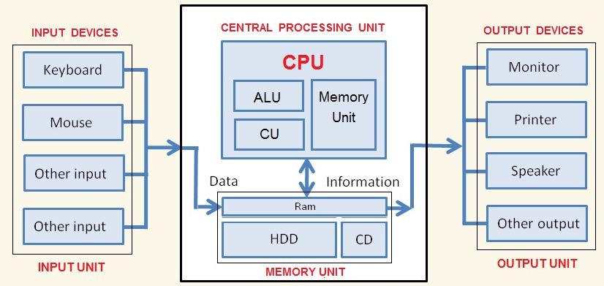
Processor

Slide 9
Processor contd.
Central Processing Unit / Microprocessor
Interprets and execute basic instructions that operate the computer
Components (Parts) of the CPU
  Control Unit
  Arithmetic Logic Unit (ALU)
  Registers

Slide 10
Control Unit
Directs and coordinates computer operations
Interprets instructions
Initiates appropriate action to carry out the instruction
Controls and directs the ALU, registers and buses

Slide 11
ALU
Performs arithmetic and comparison operations
  Arithmetic – addition, division, multiplication & subtraction
  Comparison – less than, greater than, equal

Slide 12
Register
A staging area built into the CPU
Internal registers can only be accessed by the CPU
  Some are user-accessible
Common types of registers
  Instruction Register (IR)
    Holds instruction that is currently being executed
  Memory Buffer Register (MBR)
    Holds data being transferred to/from main memory
  Memory Address Register (MAR)
    Holds the address (location) of the main memory for storing or retrieving data
  Program Counter (PC)
    Holds the address of the next instruction to be executed

Slide 13
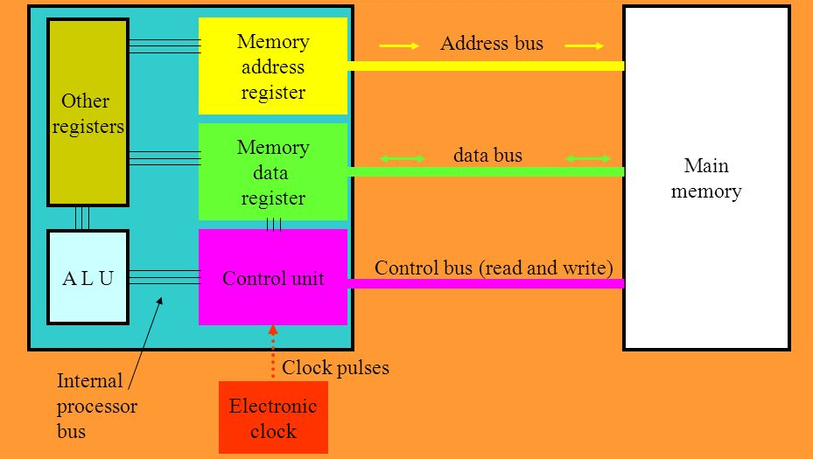
The processor structure

Slide 14
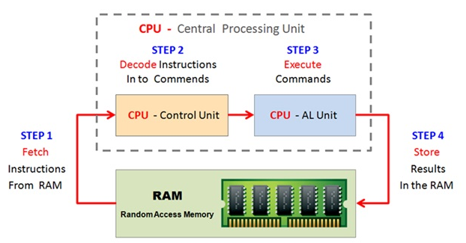
Machine Cycle
Activities that take place during processor execution
Machine Cycle made up of two stages
  Instruction cycle
    Fetch
    Decode
  Execution cycle
    Execute
    Store

Slide 15
Bus Channel
A pathway for transmitting electrical signals between devices and components.
Bits travel on a bus
Data Bus
  Transmit bits that represents actual data
Address Bus
  Transmits bits that represent the location (address) of where the data resides in memory
Bus Width
  Determines the number of bits that can be transmitted at one time
  Bus width influences the processor’s word
  Buses have clocks that controls transmission speed of the bus

Slide 16
Bus contd.
Kinds of Buses
System bus
  Connects the processor to the main memory
  Part of the motherboard
  Also called Front Side Bus (FSB)
Backside bus (BSB)
  Connects the processor to the cache
Expansion bus
  Connects the processor to other peripheral devices
  E.g. video card
Examples of buses
  USB (Universal Serial Bus)
  SATA
  SCSI (Small Computer System Interface)
  PCI
  Thunderbolt

Slide 17
Power Supply
Computers run on electrical power
Electrical charge
  Represents data (bits)
  Provides power to drive the components
2 forms of electrical charge
  Alternating Current (AC)
    Unstable and spike prone
    110 ~ 240 volts
  Direct Current (DC)
    Stable
    5 ~ 15 volts
Power supply converts AC to DC
  Contain a voltage switch
  Fan to dissipate heat

Slide 18
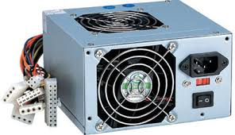
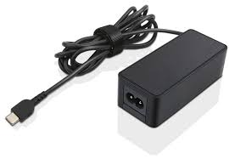
Power Supply contd.

Slide 19
Acknowledgement
www.davescomputertips.com
www.bechtle.com
www.learningcomputerscienceonline.com

